Slide 1

DJANGO STATIC FILES AND TEMPLATE EXTENDING - The MVC design pattern
Web 3

Slide 2
Static Files
Django refers to Javascript, CSS, and any icons or other images that come with your code for your site as static assets.
The first step to integrate static assets in a Django project is to configure Django project settings so that it knows what folder static assets are located in
Django comes with a template tag called static that helps us create the paths to our static assets
To make use of the static tag, we need to use a load tag to load the static files template tag, because it isn't provided by default.
{% load staticfiles %} this will make a tag called static available in the rest of our template.

Slide 3
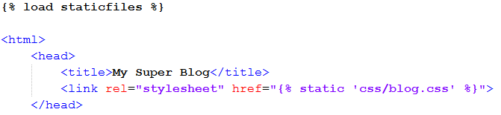
Static Files

Slide 4
Template extending
To reduce repetition (DRY), Django projects implement a base template with the elements that every template will use
metatags,
global CSS or JavaScript
structural elements such as a navigation bar

Slide 5
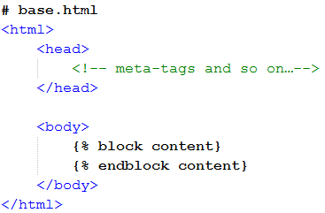
Template inheritance
To reduce repetition, Django projects implement a base template with the elements that every template will use, such as metatags, any global CSS or JavaScript, and structural elements such as a navigation bar.
In its body tag, we have a block template tag to provide a place for child templates to define content.
base.html
Notes:
# base.html
<html>
<head>
<!-- meta-tags and so on…-->
</head>
<body>
{% block content}
{% endblock content}
</body>
</html>

Slide 6
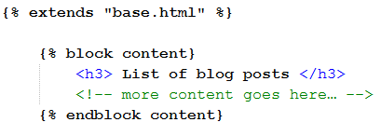
Template inheritance
index.html
In index.html the extends tag establishes that it will use base.html as its parent template.
Note that this tag has to be the first line of the template.
Any block tags in this template will be used to indicate an area of content that will override the parent.
In the example, we're overriding the block called "content."
When rendered, the index.html template will have the HTML from the base template, and its body tag will be filled with whatever's placed in the content block
such as the h3 tag and the comment we have here.
Notes:
# index.html
{% extends "base.html" %}
{% block content}
<h3> List of blog posts </h3>
<!-- more content goes here… -->
{% endblock content}

Slide 8
Design Patterns
The main idea behind design patterns is to extract the high level interactions between objects and reuse their behaviors from application to application.
Pattern describes a problem which occurs over and over again in our environment, and then describes the core of the solution to that problem, in such a way that you can use this solution a million times over, without ever doing it the same way twice.

Slide 9
What is MVC?
Architectural design pattern which works to separate data and UI for a more cohesive and modularized system
Model represents the data model
Manages behavior and data of the application domain
View represents the screen(s) shown to the user
Manages the graphical and/or textual output to the display of the application
Controller represents interactions from the user that changes the data and the view
Interprets the mouse and keyboard inputs from the user, commanding the model and/or the view to change as appropriate

Slide 10
How does it work?
User inputs a command
Controller handles input and updates model or changes the view
View, which relies on model to show data to user, updates if necessary
Rinse and Repeat

Slide 11
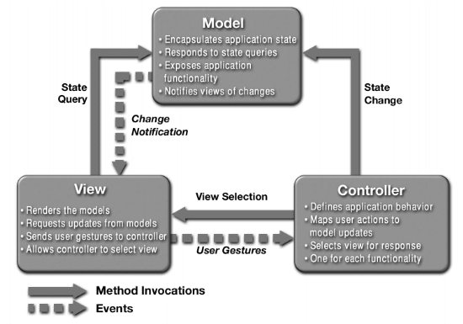
What is MVC?

Slide 12
What’s the point?
Provides a logical structure for heavily interactive system
Adheres to good engineering design principles and practices
Information hiding, less coupling, simplicity, etc.
Delegated control style
Separation between the data layer and the interface is the key:
The view is easily replaced or expanded.
Model data changes are reflected in all interfaces because all views are Observers.
Better scalability since UI and application logic are separated.
Distribution over a network is greatly simplified.

Slide 13
In Django MVC is MVT
M= model, the database interface
V= view, logic for getting stuff in and out of the database
T=template, the display logic

Slide 14
Model
Database interface and abstraction
Supports
MySQL
Oracle
Postgre
SQLite
IBM DB2
MSsql

Slide 15
View
Most business logic
Edits
Calculations
Permissions
Many libraries available

Slide 16
Template
Simple template language
Can be used with most advanced front end tools
AJAX
Jquery

Slide 17
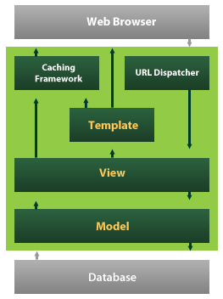
Django architecture

Slide 18
Project directory structure
demosite/ ----------------------Just a container for your project. Its name doesn’t matter to Django; you can rename
it to anything you like.
manage.py --------------A command-line utility that lets you interact with this Django project in various ways.
. You should never have to edit this file.
demosite/ ---------------Actual Python package for your project. Use this name to import anything inside it
(e.g. import demosite.settings)
__init__.py ---------A file required for Python to treat the demosite directory as a package.
settings.py --------Settings/configuration for this Django project
urls.py ------------Root URL config, the URLs for this Django project, provides mapping to views
wsgi.py -----------An entry-point for WSGI-compatible webservers to serve your project
templates/ ------ HTML files , renders based on views. You can change to any dir, configurable in settings.py
static/ ------------ CSS, JS, images.. etc, configurable in settings.py
demoapp/ ------------Can application of the demosite project
__init__.py -------- A file required for Python to treat the demoapp directory as a package
urls.py ------------ URL config, the URLs for this Django app, provides mapping to views
views.py ---------- Responsible for processing a user’s request and for returning the response
models.py --------- A model is the single, definitive source of information about your data.
Generally, each model maps to a single database table.
admin.py ---------- It reads metadata in your model to provide a powerful and production-ready interface
forms.py ----------- To create and manipulate form data

Slide 19
Settings
Project settings.py overrides <python>/Lib/site-packgaes/django/conf/global_settings.py and tells your django project which settings to be used. (demoproject.settings)
DEBUG True or False
DATABASES ENGINE postgresql_psycopg2', 'mysql', 'sqlite3' or 'oracle'.. etc
ROOT_URLCONF Root url dispatcher specs
MEDIA_ROOT directory that will hold user-uploaded files
MEDIA_URL To serve media files
STATIC_ROOT To any server static files css, js.. and admin UI files (can add more dirs to STATICFILES_DIRS)
STATIC_URL To serve static files
TEMPLATE_DIRS Template directories
Using settings in Python code
from django.conf import settings
if settings.DEBUG:
# Do something

Slide 20
Project/site creation
Creating new Project
django-admin.py startproject demoproject
A project is a collection of applications
Creating new Application
python manage.py startapp demosite
An application tries to provide a single, relatively self-contained set of related functions
Using the built-in web server
python manage.py runserver
python manage.py runserver 80
Runs by default at port 8000
It checks for any error and validate the models. Throws errors/warnings for any misconfigurations and invalid entries.

Slide 21
URL dispatcher/patterns
Root URL should be configured in settings.py
ROOT_URLCONF = 'app.urls'
Syntax
patterns(prefix,
(regular expression, Python callback function [, optional dictionary [, optional name]])
)
Example:
urlpatterns = patterns(' ',
(r'^articles-year/$', 'mysite.news.views.articles_year'),
)

Slide 22
URL dispatcher/patterns
Can include other URLconf modules
urlpatterns = patterns(' ',
url(r'^support/', include('demoproject.support.urls')),
)
Using Prefix
urlpatterns = patterns(' ',
(r'^articles/(\d{4})/$', 'mysite.news.views.articles_year'),
(r'^articles/(\d{4})/(\d{2})/$', 'mysite.news.views.articles_month'),
)
Here mysite.news.views is common, so can be rewritten as follows
urlpatterns = patterns('mysite.news.views',
(r'^articles/(\d{4})/$', 'articles_year'),
(r'^articles/(\d{4})/(\d{2})/$', 'articles_month'),
)
Passing extra arguments and Dictionary mapping
patterns(' ',
(r'^articles/(?P<year>\d{4})/$', 'articles_year'), {'foo': 'bar'}),
)
We can get the values in views.py as year='2005', foo='bar'

